Slide 1


Text Analysis INTENSIVE: When and How to Use it
Instructor: Nick Adams
w/ special thanks to Laura Nelson

Slide 2
Goals
DAY ONE
To build intuition about various text analysis approaches
Their strengths and limitations
How each works
What kinds of questions they can answer
To practice our intuition by talking through our own research applications
DAY TWO
To demonstrate 2 or 3 of these approaches in R
DAY THREE
To practice the approaches in R
Ulterior Motive: To recruit you into the ‘big text’ revolution ☺

Slide 3
Who are we?
Name, Dept
What kind of text data? (if you know)
What sorts of questions? (if you know)

Slide 4
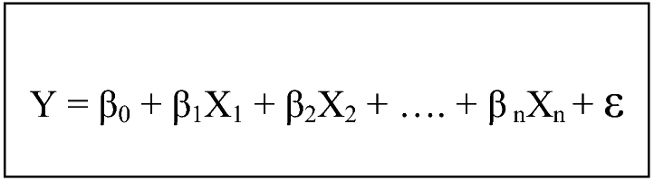
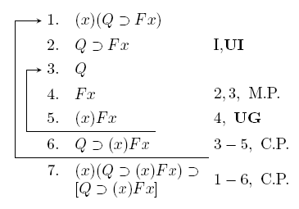
Theory
Artificial Language
import scipy
from scipy import sparse
n = 200000
matrix = scipy.sparse.rand(n, n, density=.001)
print matrix
Natural Language
“Time flies like an arrow. Fruit flies like a banana.”
Notes:
Natural versus constructed language
It's difficult to analyze because it's a natural language. Natural languages arise unpremediated, in the minds of humans. Language people use to communicate with one another. This is opposed to constructed or formal language, e.g. formal logic or computer language. Constructed languages are designed to be completely unambigious—every symbol is unique and means/produces only one thing, and everyone who learns the language will interpret it the exact same way. Natural languages are ambiguous. The same word can mean different things in different contexts. People use metaphors and complex constructions:
Time flies like an arrow. Fruit flies like a banana.
Even if two people know the same language, they might interpret the same sentence differently.
And it's constantly in flux. Language is changing. One word now may not mean the same thing it did 100 years ago, and may not mean the same thing 100 years from now. For example,
CUTE
Cute was a shortened form of acute, meaning “keenly perceptive and shrewd” in the 1730s.
But by the 1830s it was part of American student slang, meaning “pretty, charming and dainty”.
And, bizarrely, the original sense of “dainty” was “worthy and substantial”. Bank vs. bank?
The problem is meaning. What does natural language mean? What information can we get from it?
It's complicated.
For social scientists and humanists, natural language is often the only data we have. Text, whether
written or transcribed, is everywhere.

Slide 5
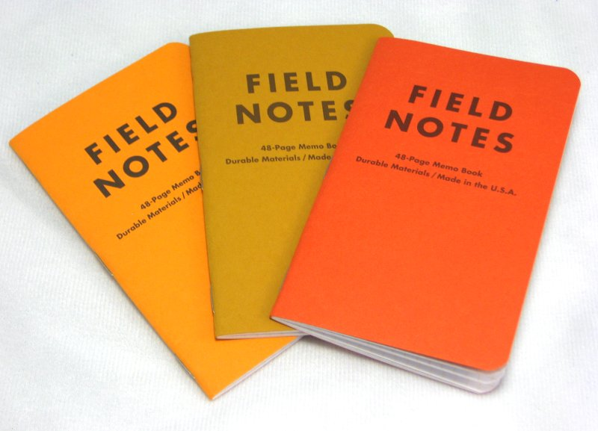

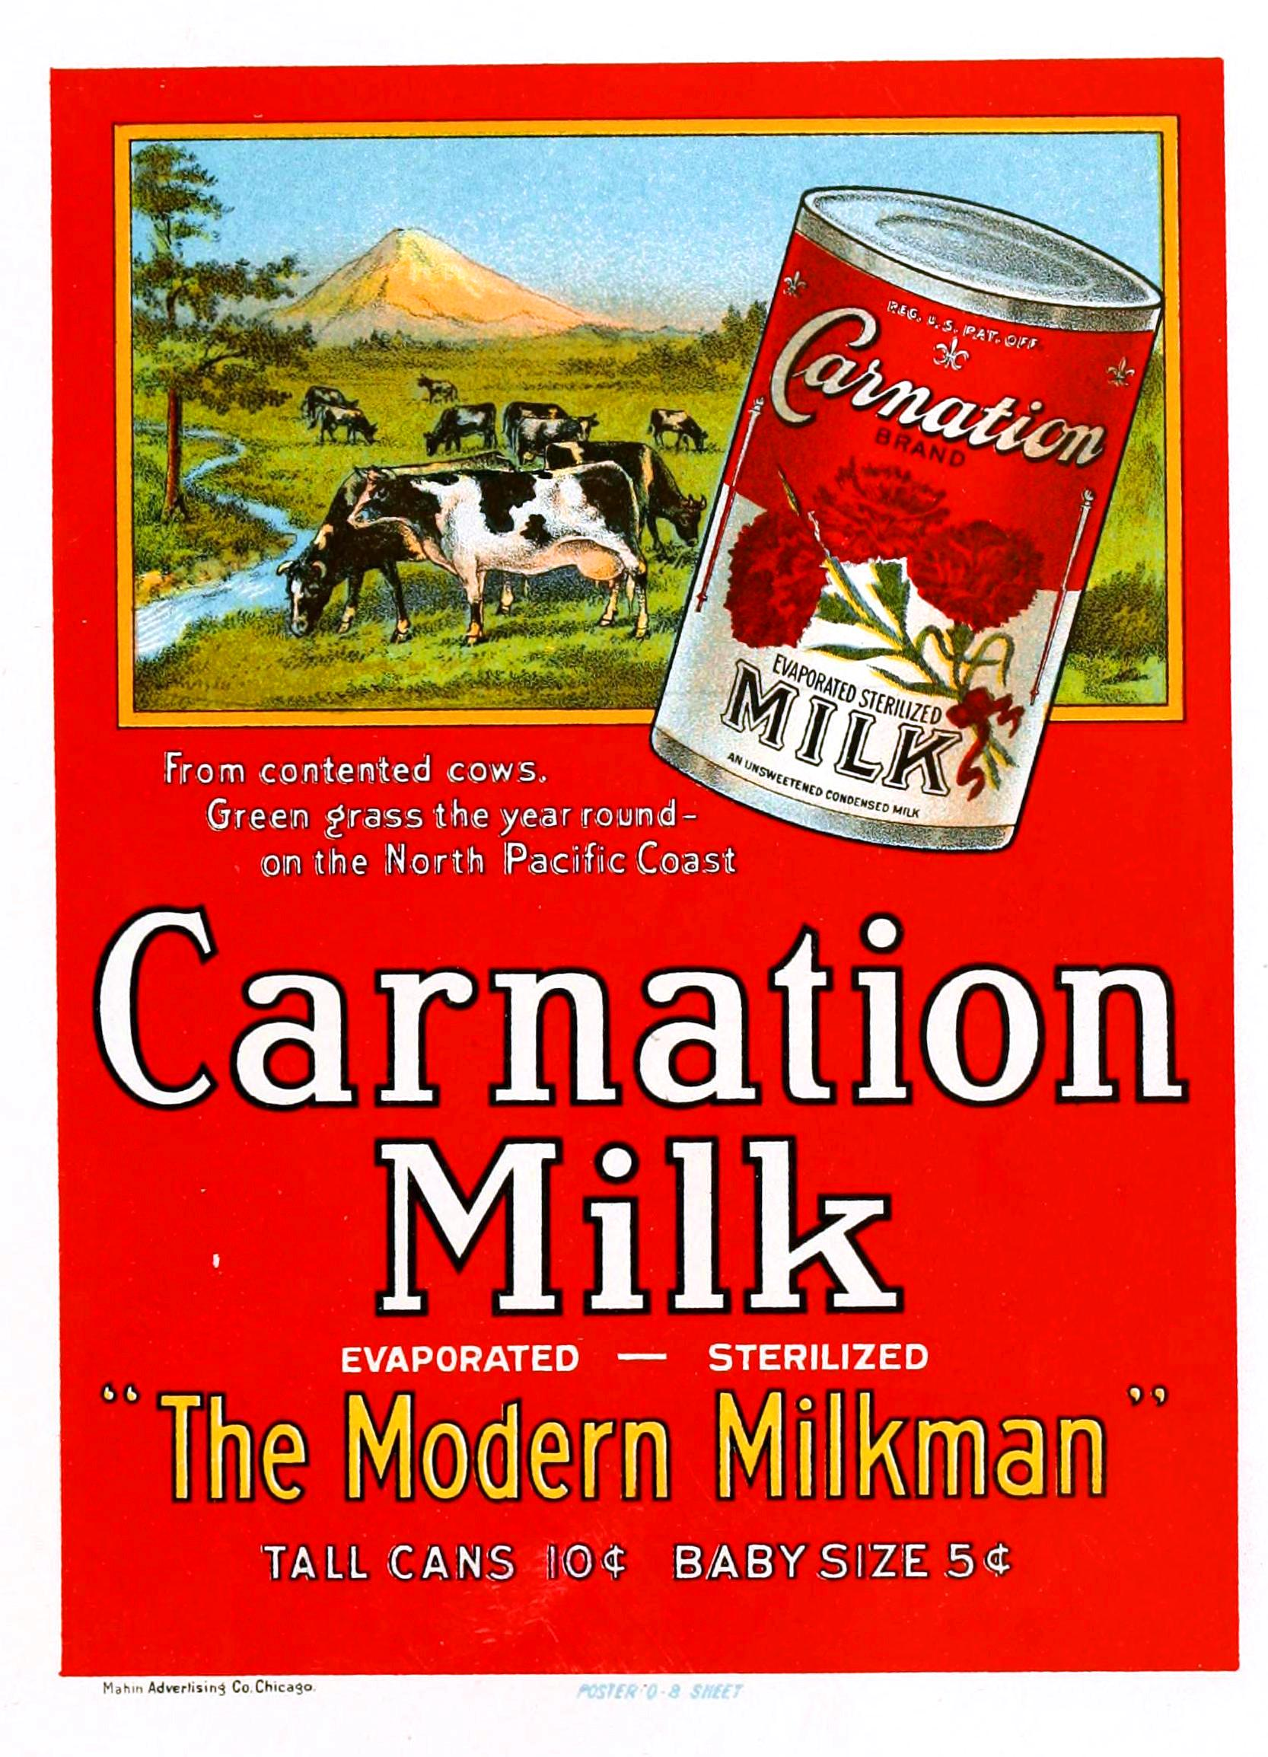

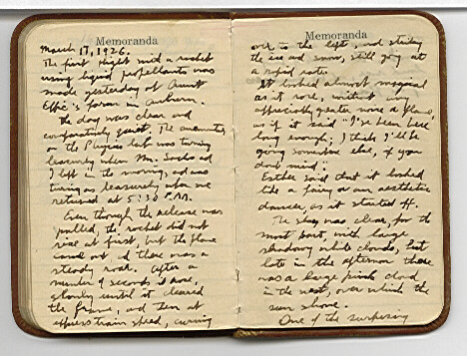

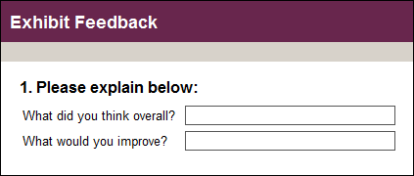

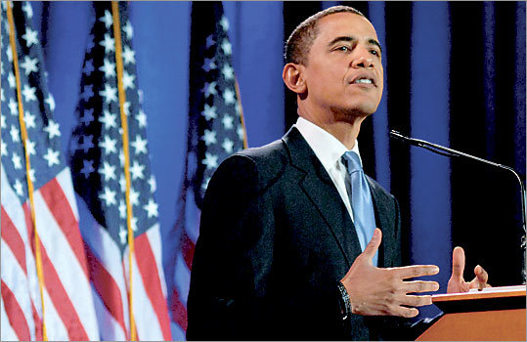
Natural Language as Data
Notes:
Text is a source of data
-Newspapers, political speeches, advertisements,diaries, facebook posts, tweets, interview transcripts, field notes, open ended survey questions. Text is everywhere. It is language, it is culture, it is a record of events, record of opinions, description of people.

Slide 6

How Do We Humans Analyze Text?
“We need to steer clear of this poverty of ambition, where people want to drive fancy cars and wear nice clothes and live in nice apartments but don't want to work hard to accomplish these things. Everyone should try to realize their full potential.” -Barack Obama
Notes:
We thus must have a way to analyze text.
Types of text analysis
1. Humanists:
-Qualitative, deep reading. Seek to answer the question, what does this text mean? What does it tell us about who produced it, and the society in which it was produced?
Pros: Provides context Some say it is the only way to extract meaning
Cons: Time consuming, Dependent on who is doing the reading, non reproducible? (Debates about this), Risk of confirmation bias, cherry picking quotes.
Example: Obama is combining a critique of the American dream with an endorsement of the American dream. He is critiquing the idea that ambition is good, particularly if ambition includes material goods. But he is endorsing the American dream by claiming we should all work hard to realize our full potential. He is couching conservative ideas in liberal terms (poverty of ambition). It is a cunning political strategy.
2. Some humanists, interpretive sociologists, some quantitative sociologists:
-Coding categories. Usually hand coded, or training people to code. Come up with categories, code text in the categories, count occurrences and co-occurrences of categories. John Evans, instrumental and rational action, Ferree, abortion discourse between countries.
Pros: Does take into account context, attempts to capture meaning, but tries to guarantee you're not cherry picking quotes. Purpose to be more objective., Can identify patterns not identifyable but one human reading. Can process much larger amounts of text and reveal patterns across the text.
Cons: Coding can be ambiguous. It's difficult to get two people to code text in the same way, which questions the validity of the project of coding.
Codes: anti material ambition, pro-working hard. Do these show up in other quotes, from other presidents?
3. Political scientists/economists/quantitative sociologists:
-Turn text into numbers, quantify text. Seek to draw variables out of text that can be used in quantitative analysis. Can be word counts, number of words, types of words (part of speech), subject-action-object (Franzosi)
Pros: Does not rely on human interpretation, coding of categories. Researcher is not imposing codes onto the text.
Cons: Completely loses context. Word counts miss ambiguity in meaning, bank (river) and bank (money) will be counted the same. Misses the meaning of the text. Hard to understand what a pattern signifies. More verbs in one text, what does that mean? Do you count verbs, or verbals?
There are
-Categories or words? Words are slightly more straight forward, categories contain more information and more meaning.
-Finally, any of this can be done deductively or inductively
Test for particular patterns, see what patterns arise from the data itself.
The technology to do all this is changing, and methods are changing along with it. Now, we have the ability to a wide range of techniques under the umbrella computer-assisted text analysis. This is what I will discuss. Understanding the debates about text analysis, and different methods, is critical before you can apply computer-assisted text analysis. This is a tool, not a method in itself, you must think carefully about what the text analysis is doing, and what conclusions you can draw from different techniques. This workshop will introduce you to a number of techniques, suggest what types of questions you can answer with different techniques, give you current best practices, and provide you with the tools to use these techniques in your own research by going through some examples.

Slide 7
De-mystifying Some Terms
Meta-Data: variables about units of text or documents
Corpus: Collection of texts/documents
Lexical: fancy name for word
N-gram
poverty: uni-gram
poverty of: bi-gram
poverty of ambition: tri-gram
Notes:
-Important terms:
Lexical: fancy name for word
Corpus: collection of texts
n-gram: a gram is a word, a uni-gram is one word, a bi-gram is two words, etc.

Slide 8
Structured vs. Unstructured Data
Legal rulings
Semi-structured interviews
Police Reports
Diary entries
Open-ended survey questions
News reports
Student essays
Letters or emails
Medical forms
Academic journal articles
Notes:
Order these with your partner

Slide 9
What is Structure to a Machine?
?
?
?
?
Notes:
Grammar – SVO
Proximity -
Sameness –
Difference across corpora
of phonemes/roots; words; N-grams
Fields in a survey or form
Or maybe a by line
A hashtag delimits a topic
An @ symbol delimits a twitter account

Slide 10
Why Use Computer-Assisted Methods?
Reliability / Reproducibility
Validity
Unburdened by human biases (emotions, specialized knowledge, etc.)
Read differently (??maybe better some times??)
See patterns better (sometimes)
Speed
Humans are slow
Text is becoming ‘big data’
Does not remove the need for interpretation!
Notes:
-Augment humans.
-Humans are slow, can only work limited hours, are expensive because they need to eat. Plus, they are people so you need to treat them well. Pay them well, don't over-work them, etc.
Computers are comparatively cheaper, they work 24 hours a day, you can abuse them. They can do things much faster and much more efficiently than humans.
-Humans are not as reliable. It's remarkably difficult to get them to code text the same way as each other, they often won't code text the same way two different times.
You know exactly what computers are doing, with the same input they will do the exact same thing every time. It's easy to measure accuracy rates. With similar data accuracy will be the same. -Can write down procedure. If someone has your data, coding scheme, and method, they can exactly reproduce what you did. I want to emphasize: that doesn't mean its valid, but it is reliable.
-Replace humans (at first)
Computers read differently than humans, thus they may be able to lead us to different ways of looking at text. Much more memory, can quickly match patterns, are not burdened by experience, emotion, bias. We can use this to our advantage.

Slide 11
Types of Automated Text Analysis
DEDUCTIVE
Classification
Dictionary Approach -- count words of interest
Supervised Machine Learning – categorize text by hand then ‘train’ computer to do the same
INDUCTIVE
Difference of proportions
'Word scores,’ TF-IDF
Clustering
Topic modeling
What is diff about these separate corpora?
What are these documents about?
Notes:
3. Types of text-analysis we will go over in this workshop.
-Classification – deductive
-Dictionaries (multiple categories per text)
-Supervised machine learning (mutually exclusive)
-Lexical selection - inductive
-Difference of proportions
-Word scores, tf-idf
Out of this can produce cosine similarity measure
-Latent categorical analysis and classification – inductive
-Clustering (each document is clustered around one of K clusters in a topic space)
-Topic modeling (multiple categories/topics per text/document)
I will go over each of these methods, identify types of questions it might answer, type of data you need, suggest some different tools for analysis, and then go over an example. Today, we will do classification, tomorrow, lexical selection and topic modeling.
But first: How to choose which method?

Slide 12
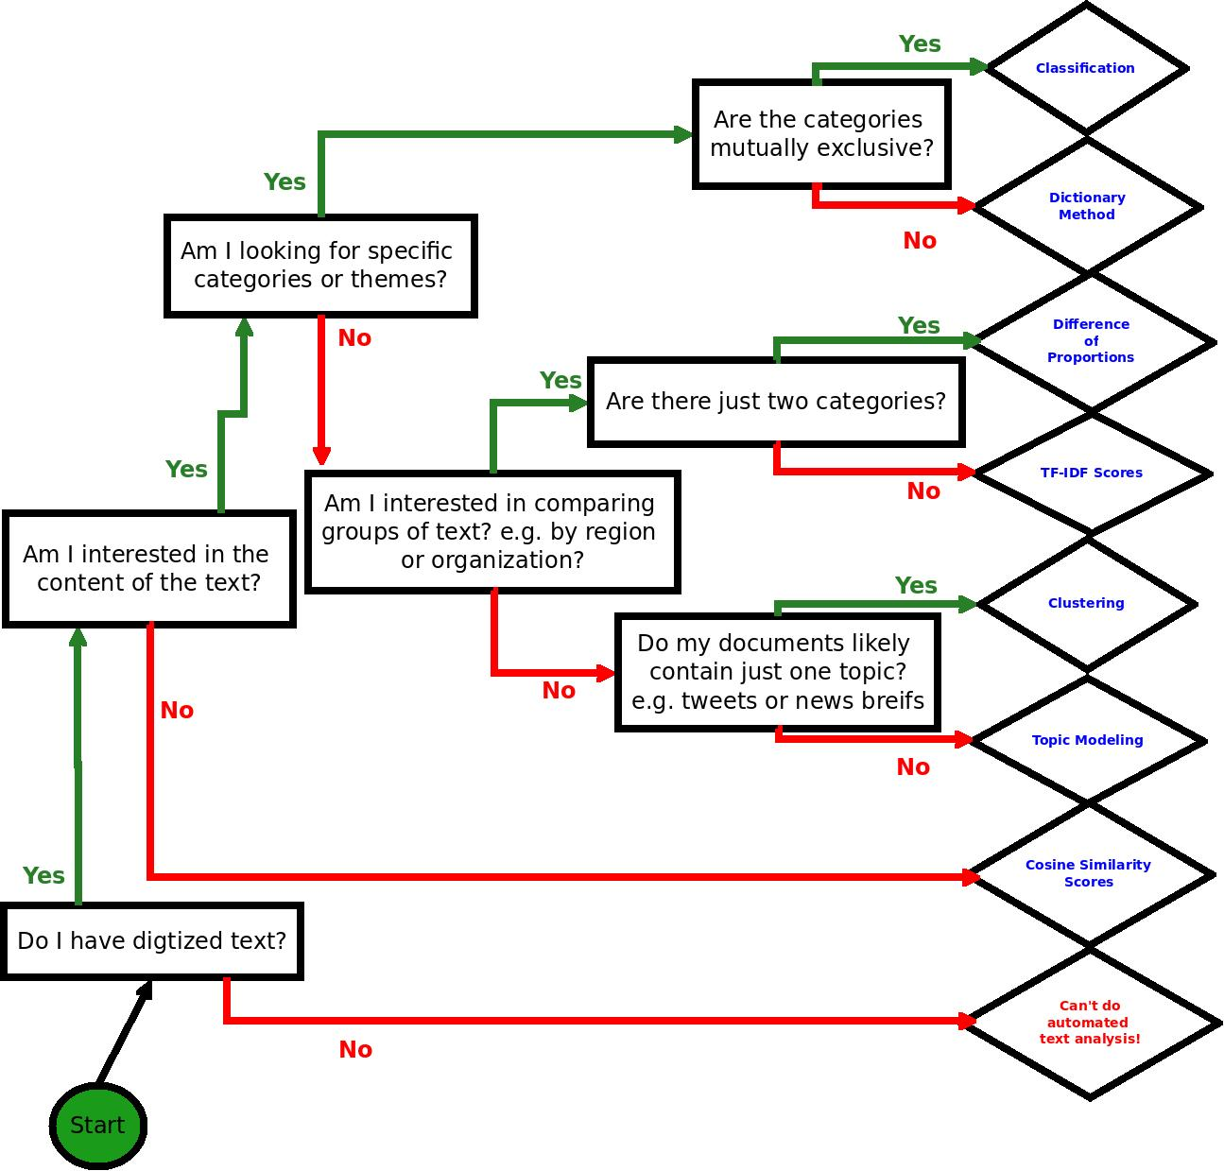
Notes:
Your first decision, can I do automated text analysis? It requires digitized text.
Cosine similarity just checks how similar the corpora are – useful for plagiarism checking. If the number is near zero, someone plagiarized
Second question, do I want to do deductive or inductive analysis?

Slide 13
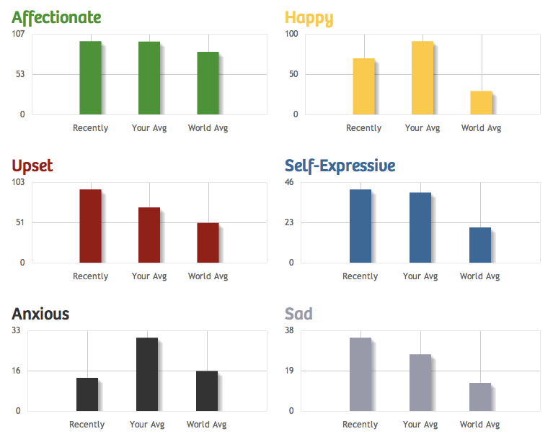
Dictionary Methods
Notes:
This has a long history in content analysis. People will count the number of times words occur in text and use that as a measure of particular topics. Now we can automate it.
Sentiment analysis is a popularly used dictionary method (though it has trouble with the word NOT; with sarcasm; etc.)
This method is particularly good if you think your documents have multiple, overlapping topics or categories. You can determine percent of document per category, rather than assign a document to a category. I.e. this document is 30% anxious and 38% self-expressive
You can use existing dictionaries, like LIWC
Or create your own. You can use WordNet for synonyms to create a fairly comprehensive dictionary for any topic or category.
You need to construct a list of mutually exclusive and exhaustive categories to use classification. Other is okay… but, it helps to have that as a small percentage.

Slide 14
Supervised Machine Learning
Start with hand-coding
Train a computer to mimic your hand-coding
We will cover this in the Text Analysis Working Group!
Meets every other Wednesday starting 9/30 3:30-5:30 pm

Slide 15
Classification: Semi-Automated Machine Learning
Label | Document Text | Function
Anti-materialist | Document 1 Text | Training
Pro-hard-work | Document 2 Text | Training
other | Document 3 Text | Training
Pro-hard-work | Document 4 Text | Test
Pro-hard-work | Document 5 Text | Test
Anti-materialist | Document 6 Text | Test
? | Document 7 Text | Unknown
? | Document 8 Text | Unknown
? | Document 9 Text | Unknown
? | Document 10 Text | Unknown
Notes:
You first need to hand-code a set of your documents into mutually exclusive and exhaustive categories. Now you have a coded set, and a non-coded set, which you would like to classify into your categories.
ReadMe: If used properly, ReadMe will report, normally within sampling error of the truth, the proportion of documents within each of the given categories among those not hand coded. ReadMe computes quantities of interest to the scientific community based on the distribution within categories but does so by skipping the more error prone intermediate step of classifing individual documents. Other procedures are also included to make processing text easy.
Or, R: RtextTools, which classifies individual documents.
Move to example, then end of day 1.

Slide 16
Analyzing Output
____true positives________
precision = true positives + false positives
recall = ___true positives_______
true positives + false negatives
Ex: An algorithm labels 30 words from a TEST document with a ‘generous’ label. 20 of those words were about ‘generosity.’ The algorithm failed to recognize 40 other instances of words that about ‘generosity.’ What is the algorithm’s precision; it’s recall? Is it ready to unleash on unlabeled documents?
Notes:
Precision = how many false positives did your algorithm avoid?
Recall= how many false negatives did your algorithm avoid?
its precision is 20/30 = 2/3 while its recall is 20/60 = 1/3.

Slide 17

Questions about Deductive Approaches?

Slide 18
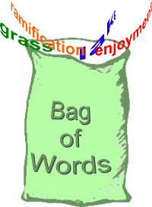
Fully Automated, Inductive Approaches
Begin here! →
What kind stuff we hav bag?
Notes:
If you are not looking for particular categories or themes, there are ways to inductively explore text. These are fully automated methods. These use a “bag-of-words” approach. The order of the words do not matter, it's just the presence and sometimes co-presence of words within a document that matters. This seems like an extreme assumption, but it turns out if you're looking for themes or topics within a text, this is the best way to do so. Using “bi-grams” or “tri-grams” does not actually add much information.

Slide 19
Pre-Processing: Bagging Words
we need steer clear poverti ambit where peopl want drive fanci car wear nice cloth live nice apart want work hard accomplish thing everyon should tri realiz full potenti
potenti apart
need steer
tri should
we ambit
wear full
nice
Notes:
Pre-processing: common but optional steps (many of the qualitative choices you will have to make to do automated text analysis)
-Remove capitalization
-Remove punctuation and numbers
-Remove stop-words (words that carry little meaning, like it, the, a)
-Stem words
Stemming words is a way to reduce the number of words in your corpus. It combines similar words into one “stem”, similar to reducing words to their root. So machine and machines would count as the same stem. You might not always want to do this. For example, I have a colleague studying the Makers movement. In her case, Make is significantly different from Makers, so she would want to keep them separate.

Slide 20
Pre-Processing
Removed “stop words”
“Stemmed” words to their roots using a Porter stemmer (created by a dude named Porter)
Removed punctuation
Removed upper case
Ready to count how many of each word remains in each document to produce…

Slide 21
Document-Term Matrix
 | ambit | poverti | peopl | full
Document1 Clinton | 40 | 20 | 0 | 10
Document2 Biden | 10 | 30 | 70 | 0
Document3 Warren | 50 | 80 | 90 | 20
Document4 Rand Paul | 90 | 20 | 40 | 10
Document5 Christie | 50 | 20 | 10 | 20
Notes:
After you do this, produce a document-term matrix. Rows are documents, columns are terms, and the cells are the frequency of each term per document. From here, you can do a number of calculations.
Documents = rows
Terms = columns

Slide 22
Exercise
Imagine Democratic vs. Republican speeches. What is different? How would we measure it?
For example, speeches on:
Immigration policy?
Economic policy?
Women’s health policy?
How might we measure these differences?
Notes:
For the tea party, you’d use TF-IDF – the same intuition but instead of using difference of proportions between two corpora/documents, you compare the frequency of a term for one corpus given all the words in the corpus to the frequency of the term in other corpora given all their words.

Slide 23
Difference of Proportions
 | ambit | poverti | peopl | full
Clinton | 40 | 20 | 0 | 10
Biden | 10 | 30 | 70 | 0
 | ambit | poverti | peopl | full | Total
Clinton | .57 | .29 | 0 | .14 | 1.0
Biden | .09 | .27 | .64 | 0 | 1.0
Diff of Prop | .48 | .02 | -.64 | .14

Slide 24
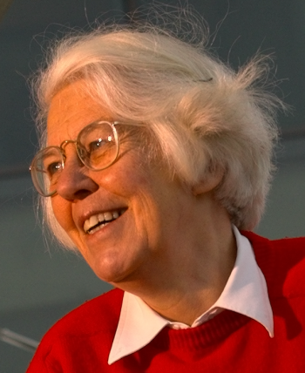
TF-IDF
(c) 1972
term frequency–inverse document frequency, is a numerical statistic that is intended to reflect how important a word is to a document in a collection or corpus. The tf-idf value increases proportionally to the number of times a word appears in the document, but is offset by the frequency of the word in the corpus, which helps to control for the fact that some words are generally more common than others.
Notes:
From Geomblog: “Once you think of documents as bags of "terms", you need a way of weighting these terms in a way that allows "similar" documents to have a similar set of weights. Term frequency (TF) is one way of doing this: weight a term with a number proportional to how often it appears. This makes some sense; a document about soccer might use the word 'football' or 'soccer' fairly often, as compared with a document on cricket.” “However, words like 'a', 'an' and 'the' also appear very often in a document. How does one prevent these terms from washing away any semantic context one might have ? One idea is to weight the term frequency by something called 'Inverse Document Frequency' (IDF). For a given collection of documents, count in how many documents a fixed term appears. This number is the term's document frequency. Clearly, a term that appears in all documents can't be a useful distinguisher of a document and so the larger this number is, the less relevant the term. Therefore, by multiplying the term frequency by a function inversely related to the document frequency (if p is the fraction of documents a term appears in, the IDF is often set equal to log(1/p)), you get a more accurate estimate of the importance of the term.”

Slide 25

Karen Spärck Jones
Professor of Computers and Information at the University of Cambridge Computer Laboratory:
2007 BCS Lovelace Medal
2007 ACM Athena Lecturer
2006 ACM – AAAI Allen Newell Award
Notes:
The Lovelace Medal is presented by the British Computer Society to individuals who have made a contribution which is of major significance in the advancement of Information Systems or which adds significantly to the understanding of Information Systems. The Lovelace Medal and associated lecture are named in memory of Ada Lovelace, who was an inspiration to the computer pioneer Charles Babbage.
The ACM have named Karen Spärck Jones the 2007 ACM Athena Lecturer. Athena Awards celebrate women researchers who have made fundamental contributions to Computer Science. The Athena Award is given by ACM-W, the ACM Committee on Women, to nominees from ACM Special Interest Groups, in this case from ACM SIGIR.
The ACM – AAAI Allen Newell Award, sponsored by the Association for Computing Machinery in conjunction with the Association for the Advancement of Artificial Intelligence, was established to honour the memory and achievements of Allen Newell. The award is presented to an individual selected for career contributions that have breadth within Computer Science, or that bridge Computer Science and other disciplines.

Slide 26
TF-IDF
Gives you output as a list of terms ranked by how unique they are to each corpus
Q: How could we know which term are most common across documents?

Slide 27
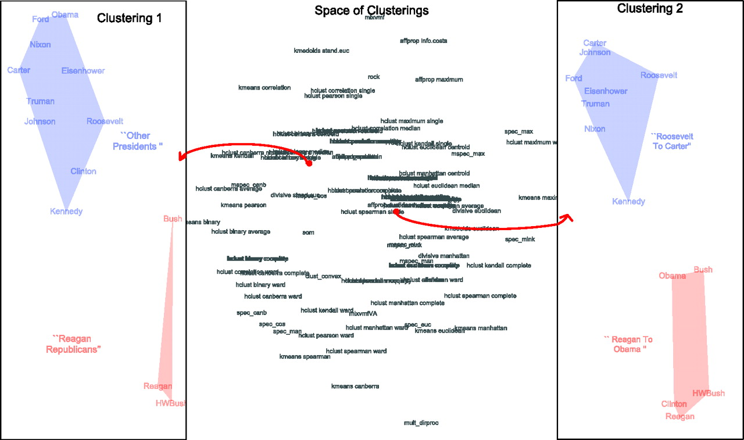
Latent Categorical Analysis
Proximity determined by various algorithms
Notes:
HUNDREDS of algorithms! No “right” answers! The upside?! No “wrong” answers either! :D
This is a way of reducing complicated text. Computer-assisted methods of text analysis seek to reduce a collection of texts, called a corpus, to its underlying structure. These methods are similar in intuition to more commonly known quantitative methods such as multiple correspondence analysis (MCA), factor analysis, and multi-dimensional scaling (MDS).
In text analysis individual data points (à la MDS and MCA), or variables ( à la PCA and factor analysis) are words. Different algorithms and mathematical operations reduce the large and complicated “dataset” (the corpus) to groups of “data points” or “variables” (words) that, when interpreted, can indicate the underlying structure of a text. Just as MCA and MDS use statistical and visual methods to reveal groupings of variables or data points that are impossible for a researcher to identify, automated text analysis approaches reveal latent categories, or groupings of words, within texts. These categories can suggest the underlying structure of diverse or seemingly unconnected texts.

Slide 28
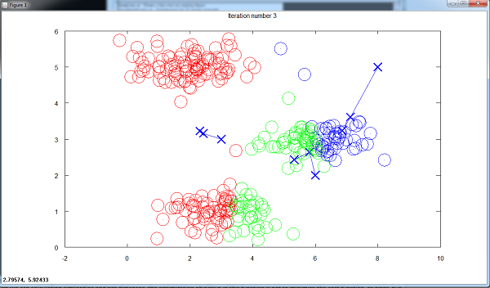
Clustering
Each circle a tweet
Notes:
If you think each of your documents have just one topic or theme, as if often the case with shorter documents like tweets or press releases, then you want to do clustering.
Examples of clusters. Look at the words, or the content of documents in those clusters, to figure out what each cluster is. Here, documents get clustered.
*You choose the number of clusters, it starts with a random center for each cluster. If the number of clusters is bad, or the random start is bad, your clusters will be poor. Do each number of clusters a few times, and ALWAYS VALIDATE YOUR CLUSTERS USING SOME OTHER METHOD!
If you want to allow many topics per document, then do topic modeling.

Slide 29
How Clustering Works
[watch K-means clustering video on youtube to acquire intuition about EM algorithms]
[Start at 2:05]
http://youtu.be/Pxhp1OhEZFc?t=2m5s

Slide 30
Clustering v. Topic Modeling
Clustering
Topic Modeling
These algorithms cluster documents according to the document-term matrix such that each cluster is based on the document similarity.
These algorithms discover “topics” of similar “terms” appearing within “documents.” Then, users can see how terms constitute topics and how topics constitute documents.

Slide 31
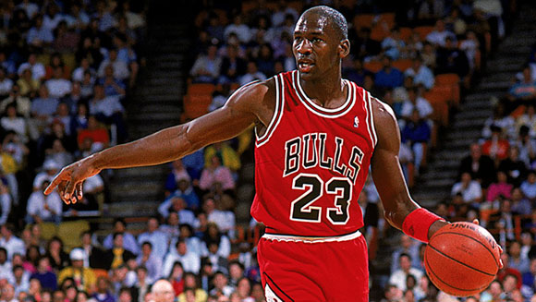

Topic Modeling
Who invented it?
Michael Jordan? OR Karen Spark Jones?

Slide 32

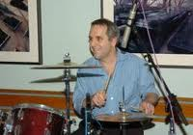
Topic Modelling
Latent Dirichlet allocation. D. M. Blei, A. Y. Ng, and M. I. Jordan. Journal of Machine Learning Research, 3, 993-1022, 2003.
Cited by 9881 !!

Slide 33
Latent Dirichlet Allocation
Each topic is a distribution over ALL words.
Topic1 | topic1_weight | Topic2 | topic2_weight | Topic3 | topic3_weight
gene | 0.5 | genetic | 0.4 | dna | 0.7
dna | 0.3 | dna | 0.2 | genetic | 0.2
genetic | 0.2 | gene | 0.2 | gene | 0.1
Sum | 1.0 |  | 1.0 |  | 1.0
Each document is a distribution over ALL topics.
Doc1 | doc1_weight | Doc2 | doc2_weight | Doc3 | doc3_weight
Topic1 | 0.6 | Topic2 | 0.8 | Topic3 | 0.5
Topic2 | 0.3 | Topic3 | 0.1 | Topic1 | 0.3
Topic3 | 0.1 | Topic1 | 0.1 | Topic2 | 0.2
Sum | 1.0 |  | 1.0 |  | 1.0
Notes:
Out of a document-term matrix you give a topic modeling algorithm the number of topics you want to find, and it give you two things:
-A distribution of each topic over all of the words (every topic contains every word, at different weights)
-A distribution of each document over all of the topics (every document “contains” every topic, at different weights)
You can then look at how the topic weights per document change over time, or if they're different per category of interest.
Again, you choose the number of topics, and it starts from a random distribution of topics. If either is bad, your output will be bad.
LDA is extremely sensitive to word choice. In model I ran it picked up a “car maintenance” topic. This is not because car maintenance was an important topic, self defense was probably more important. But because LDA is sensitive to word choice, unique words will more likely be grouped into a clear topic. Words for car maintenance are not typically used in everyday langauge. If I didn't know anything about the text I would have missed the self-defense topic, and though car maintenance was quite important. It's so important to validate your findings with topic modeling, and use some other method to do so.

Slide 34
A “Generative” Model

Slide 35
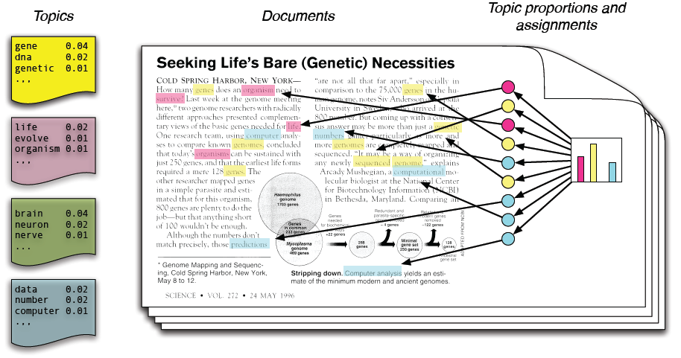
Latent Dirichlet Allocation
Notes:
Most common algorithm: LDA
--Assumes that documents are “structured” from an unknown number of topics. You want to identify the topics from which a document is structured, reverse engineer the document into topics.
Out of a document-term matrix you give a topic modeling algorithm the number of topics you want to find, and it give you two things:
-A distribution of each topic over all of the words (every topic contains every word, at different weights)
-A distribution of each document over all of the topics (every document “contains” every topic, at different weights)
You can then look at how the topic weights per document change over time, or if they're different per category of interest.
-Example from Laura’s work

Slide 36
Topic Modeling
It does:
Allow categories/topics to arise inductively
Find latent topics
Find patterns across documents
Handle large and diverse corpora
Find key differences between topics
It does not:
Find the “one” best way to categorize text
Capture the categories you want
Tell you who does what to whom, etc.
Magically reveal meaning
Notes:
7. Topic modeling
People have a lot of misconceptions about topic modeling. What you should know:
What topic modeling can do:
BE SURE TO NOTE THAT DOCS can be defined as sentences, paragraphs, etc.
It allows categories to arise inductively from text, removing the need to artificially impose a structure on the text prior to analyzing the text itself.
Similarly, it can be used to discover patterns across text, or categories within text, that you may not be considering or may not be immediately available to a human reader. Topic modeling should be used to uncover latent categories within text to advance our understanding of what the text means and what it says about the social world that created it. Often surprising but analytically useful categories may be revealed.
It can deal with large and diverse corpuses that you as a researcher are struggling to make sense of.
It can help identify key differences between the topics addressed in different texts, or can identify how topical focus changes over time.
What topic modeling can not do:
Topic modeling does not find the “one”, only, or “best” way to categorize text. There are hundreds of topic modeling algorithms each producing different word clusters, and within each algorithm varying the number of topics produces different word clusters, ultimately allowing close to infinite ways to categorize text. This method works if it reveals new or productive patterns in the text that will help you understand the phenomenon of interest, not by objectively or definitively categorizing text.
It does not work if you already have categories in mind. To use an empirical example, in his recent article published in Mobilization, Alex Hanna analyzed whether posts on a political Facebook group wall dealt specifically with different types of mobilization efforts (“Computer-Aided Content Analysis of Digitally Enabled Movements” 18(4): 367-388, 2013). Because he had specific categories in mind topic modeling would have been entirely unhelpful. Instead, he correctly chose a supervised machine learning approach where he had control of the categories into which texts were classified, allowing him to directly answer his question.
It does not determine who does what to whom. If you’re interested in this type of question you’ll need a language model that does incorporate grammar.
It does not reveal statistical differences between texts or categories. Other methods are needed to do this.
It definitely will not magically help us understand the black box of culture. It’s science, not magic, and any science takes work.

Slide 37
Laura Nelson’s Example
Four women's organizations in two cities, looking at difference in women’s movements across cities and time.
Method: automated text analysis--LDA and difference of proportions
Combined methods to come to conclusions.
Notes:
Pause to Interact: How would Laura use diff of proportions

Slide 38
Results: Difference of Proportions
Redstockings DoP
movement 12.54
women 11.34
feminist 8.91
radical 8.56
liberation 7.69
political 5.81
history 5.68
feminine 3.85
male 3.52
left 2.96
revolution 2.58
consciousnessraising 2.45
oppress 2.41
CWLU DoP
chicago 5.31
children 4.59
center 4.34
union 3.61
school 3.48
abort 3.19
nixon 2.93
day 2.86
vietnam 2.57
people 2.50
city 2.44
hospital 2.38
cwlu 2.37
“Concrete”
“Abstract”

Slide 39
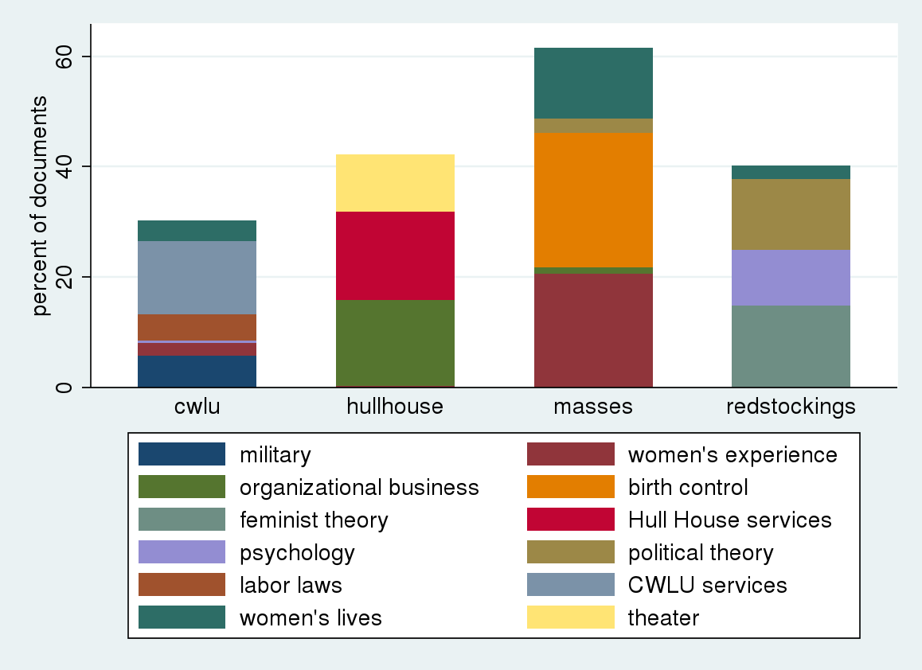
Results: LDA, Top 12 Topics
Chicago
New York
Notes:
These are 12 of the 50 topics, still confusing. So I further aggregated these topics using the results from the difference of proportions analysis: concrete and abstract.

Slide 40
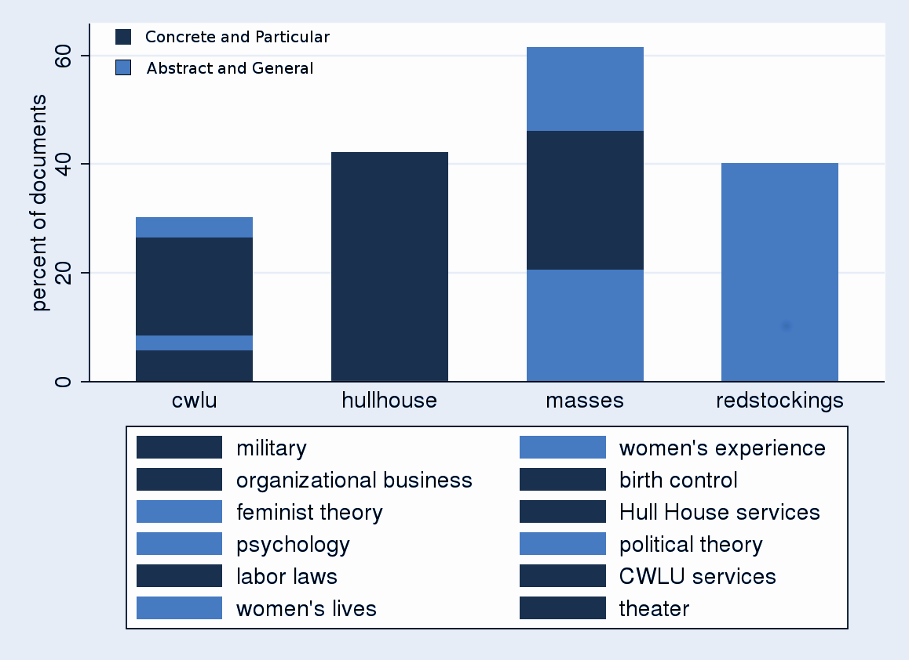
Results: LDA, Aggregated Topics
Notes:
Start with many many topic and then researcher aggregates

Slide 41
Qualitative Check
Women attorneys in private practice who are members of the Chicago Women's Liberation Union legal clinic will counsel at the YWCA-Loop Center on everything from domestic relations to criminal law. Among the most frequently asked questions at these legal clinics, said one of the attorneys, are those concerning a woman's rights in marriage, ownership rights, property rights, rights in business, and labor union problems.
---Womankind, 1973
It was 1969 when she became pregnant again. This time she wanted the baby. The birth in the middle of the night at a public hospital ward affected her badly. And when the doctor finally arrived at 9:30 a.m., the local anesthesia had worn off so that she was stitched up without it. When she got over the exhaustion following all this, she had to go to work in a mens clothing factory (which today is under investigation for unsanitary working conditions).
---Feminist Revolution, 1979

Slide 42
Summary of Findings
 | Quantitative Results | Qualitative Analysis | Political Logic
New York City | Words and categories that are abstract and general dominate. | The authors used stories and narratives to make generalizable claims about the social world that are applicable to all women, abstracting these stories to claims about social structure. | Social change happens through individuals Strategy: Change individual consciousness
Chicago | Words and categories that are concrete and particular dominate. | The documents outline each organization's attempts to identify concrete needs of the community and their efforts to take practical steps toward meeting those needs. | Social change happens through institutions Strategy: short-term goals winning concrete changes

Slide 43
Conclusion
Computers can be helpful, but...
Still requires qualitative choices
Stem words? Remove stop words? Which stop words? Remove frequent/infrequent words? How many clusters? How many topics?
They will not do the interpretive work for you!
Choose methods based on your question
Combine different methods
Validate, validate, validate!

Slide 44
Notes:
Your first decision, can I do automated text analysis? It requires digitized text. Second question, do I want to do deductive or inductive analysis?

Slide 45
Our Projects!
What kinds of questions do we want to ask of our data?
What kinds of text analysis might we use?
How can we triangulate to ensure that our text analysis approaches are valid?

Slide 46
TOMORROW
Review, warm-up
Demonstration in R
Regular Expressions
Pre-Processing for Bag of Words
TF-IDF
Topic Modeling

Slide 47
WEDNESDAY
Get set up in R Studio
Go line by line through tutorials
Regular Expressions
Pre-Processing for Bag of Words
TF-IDF
Topic Modeling

Slide 48
Working Group
Additional demonstrations and tutorials of advanced Topic Modeling techniques, Machine Learning, in R and Python
Investigate other techniques like words-to-vectors
Working in groups based on topics, data types, or text analysis methods
Share what we are learning (e.g./ structural topic modelling)
Help each other through the struggle!
Learn more about tools like WordSeer and Text Thresher

Slide 49


Slide 50
Resources
Dictionary methods
http://www.liwc.net/
http://wordnet.princeton.edu/
Install these R libraries:
RTextTools
tm
SnowballC
topicmodels

